Slide 1
Sean Koppenhafer, Jaime Rodriguez,
Chad Thueson, Noah Erickson, Rishal Dass
Weekly meeting, 05/06/2015
Digital Dash
Portland State University
Department of Electrical and Computer Engineering (ECE)
Notes:
<number>
<number>

Slide 2
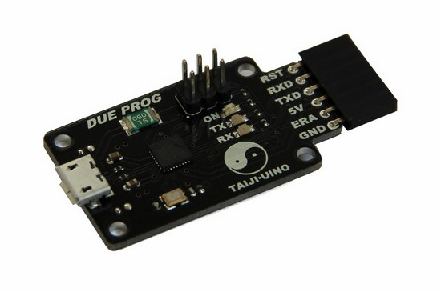
Custom Board Debug
A programming board has been ordered from China.
Parts to build our own breakout circuit have also been ordered.
One of these solutions should hopefully fix our issues with the custom board.

Slide 3
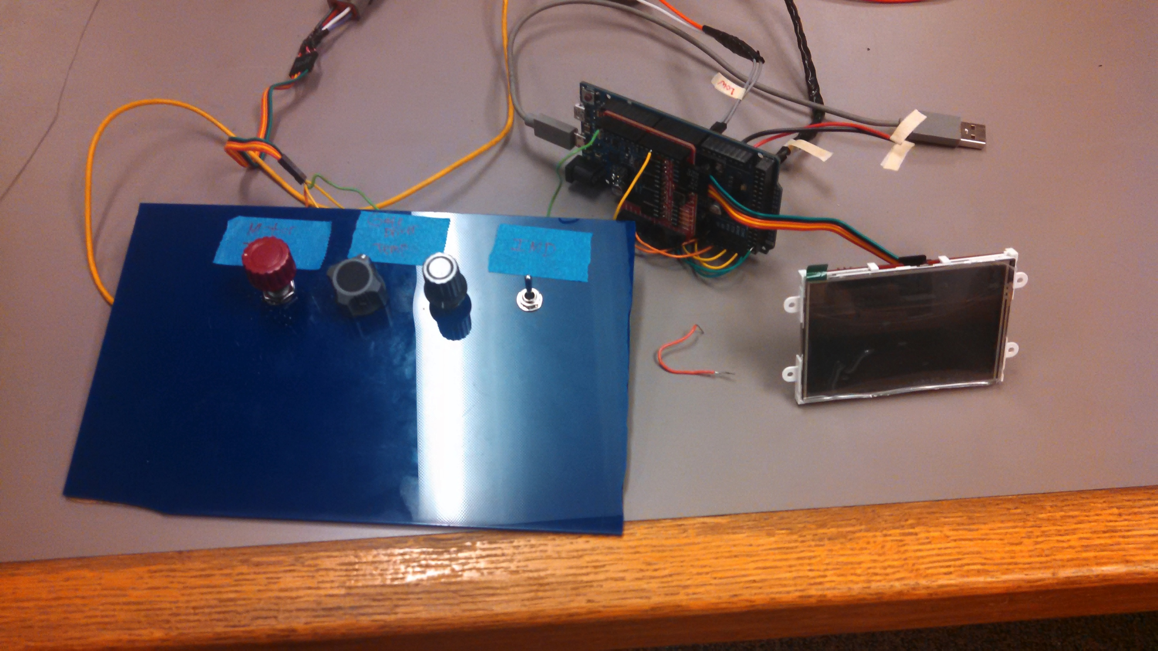
Demo Unit Updates
A debounce circuit was added to the IMD switch.
The pots sweep in voltage when read by analog pins. Need a solution for the RMS state potentiometer.
Motor temp has been switched out for motor torque.
Still debugging battery level potentiometer.

Slide 4
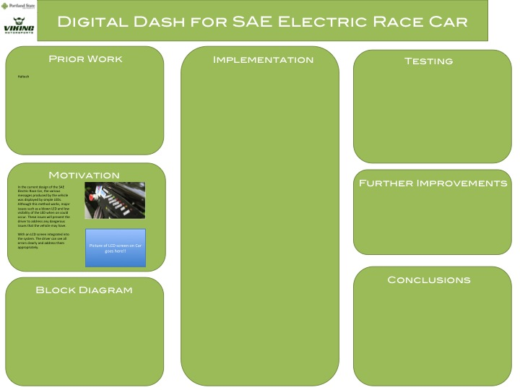
Report and Poster
Updated solution section on report.
Added more to the poster.
Will continue to update as we go.

Slide 5
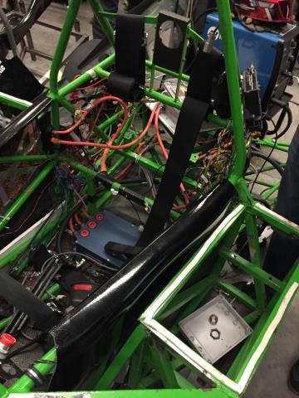
Electric Vehicle Update
In Progress
The old car is still in pieces.
The new frame is still being put together.
Progress is slow to happen.

Slide 6
Goals For The Upcoming Week
System
- Get all potentiometers working on the current iteration demo software.
- Debug custom board as parts come in.
Enclosure
- On hold until we decide on PCB vs Due.
Documentation
- Keep working on report
- Keep working on poster
- Update wiki to fit Michal's wants.
- Create a users manual for the device.
Other
- VMS progress report presentation was moved to a later date.
Notes:
<number>

